Slide 1
Inventory Management System
August Davis, Christian Hansen, David Erickson

Slide 2
Goals of the project
Ability to scan barcodes of new inventory from a cellphone camera
Organize inventory information in a format that will allow for easy viewing, editing and auditing
Have an easy to use interface
Comprehensive documentation for future developers of the project

Slide 3
Interface Progress
Goals
Current status
Prioritizing Android compatibility using a web-based application.
Easy access to features (login, stored inventory, scanner features)
Compliant with university style guidelines
Having trouble getting project to build on some machines.
Made as a website using ASP.net
Pages exist for Create, Delete, Update, Locate, and View equipment.

Slide 4
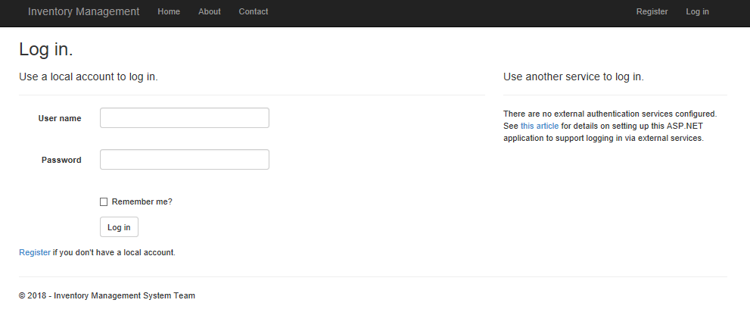

Slide 5
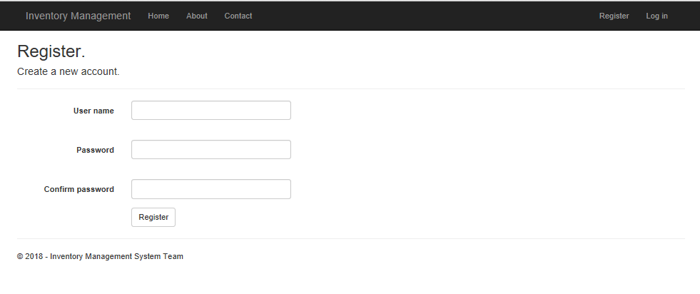

Slide 6
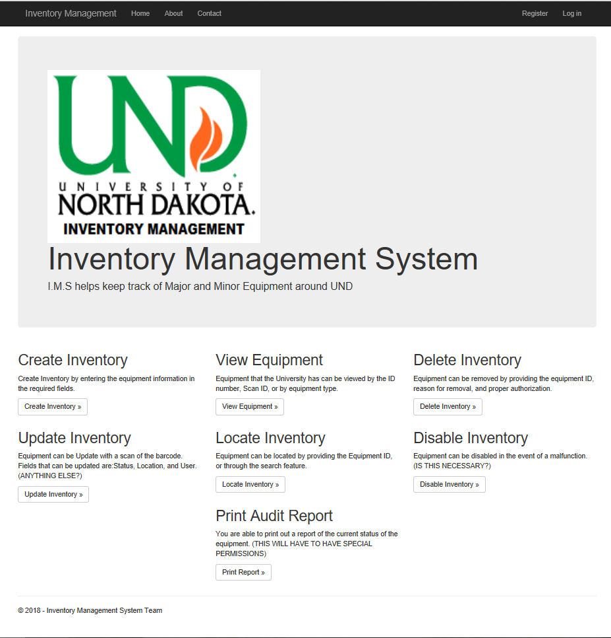

Slide 7
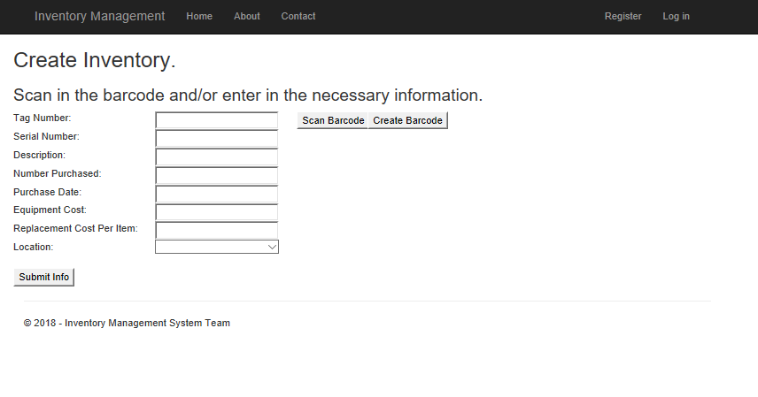

Slide 8
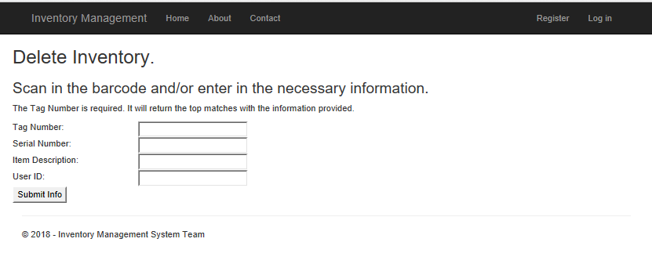

Slide 9
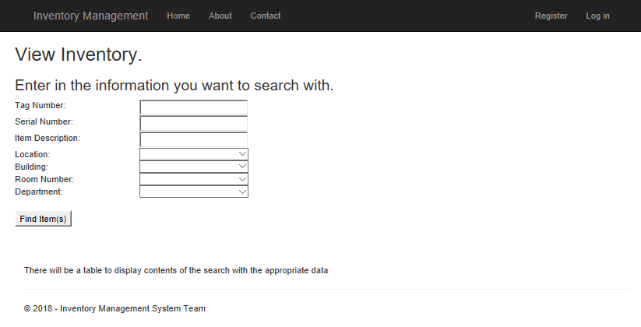

Slide 10
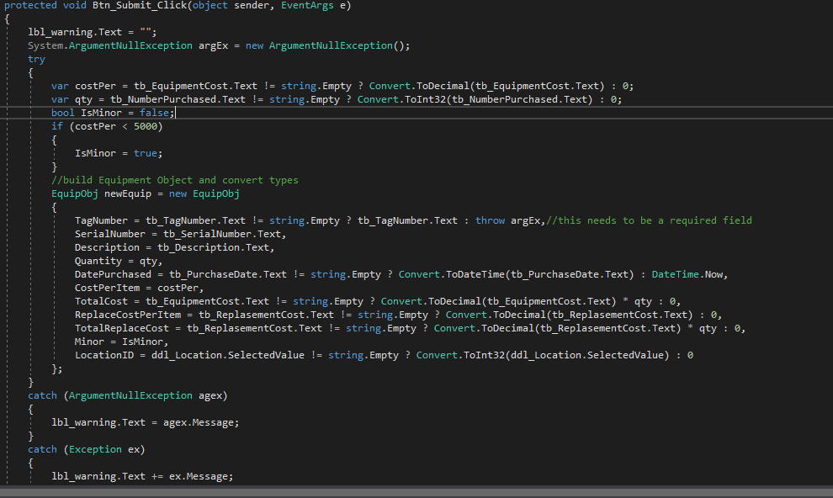

Slide 11
Storage progress
Goals
Current status
Store all relevant information for inventory items
All for easy access and manipulation of stored items
We are using Microsoft SQL Server for storage
Tables and server are set up
Backend programming to connect to DB still need to be finalized.

Slide 12
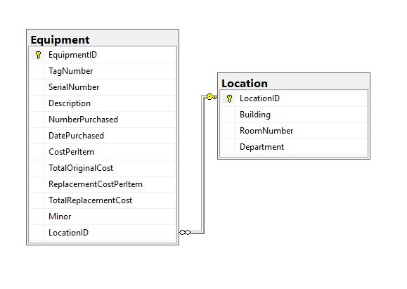
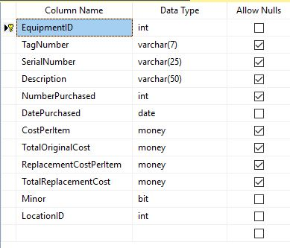

Slide 13
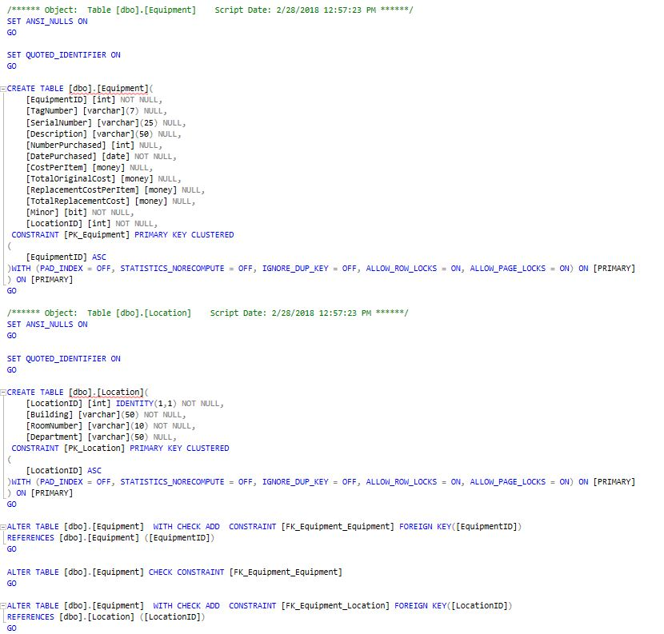

Slide 14
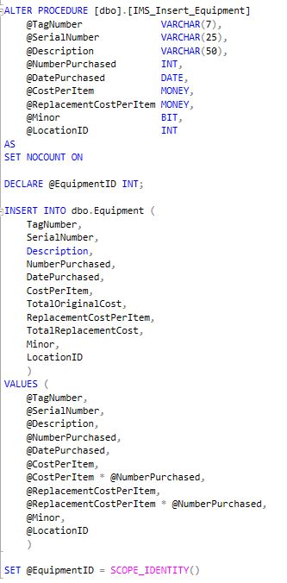

Slide 15
Scanner Progress
Goals
Current progress
Scanning the barcodes found on department inventory from a phone camera
Secondary goal: scanning barcodes from a PC
Using Free Spire.Barcode API to scan in barcodes from .png. Will be getting live scans up next.
https://www.e-iceblue.com/Introduce/barcode-for-net-introduce.html#.Wpb68UxFzt6

Slide 16
Finished. Questions?

